Slide 1
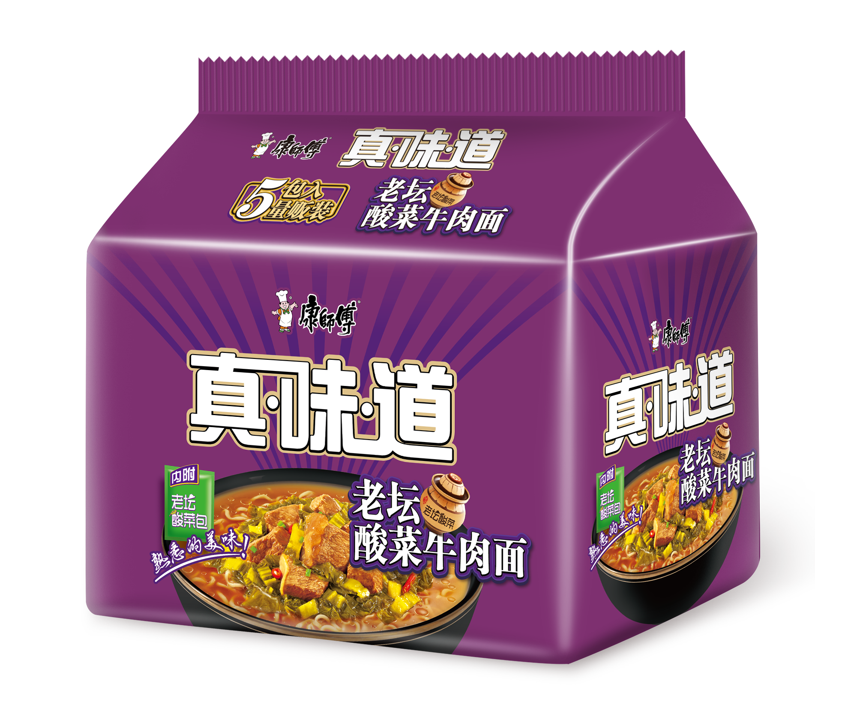

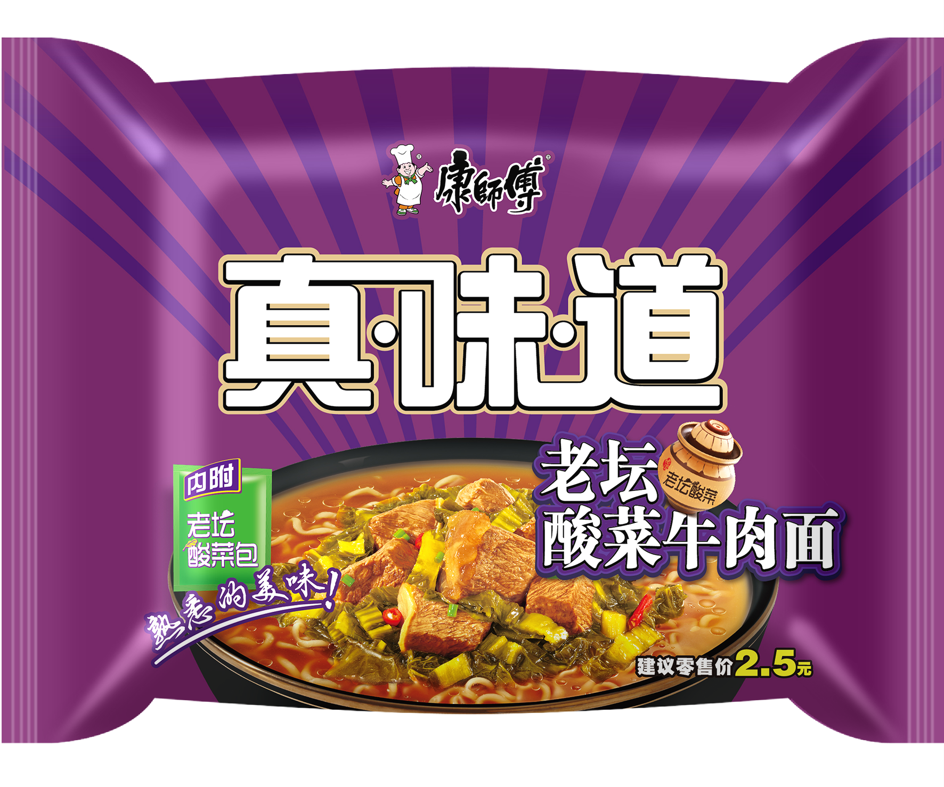
【真味道】打破必售限制 全面铺货

Slide 2
【真味道】7月达成进度
【真味道】出货检视 |  | 5月销量 | 6月销量 | 7月 |  | 占比 经典 (对应口味) | 规格结构 |  |  | 口味结构 |  |  | 渗透率 |  |  |  |  |  |  |  | 实盘库存 |  |  |  | 8月
 |  |  |  | 销量 | 达成 |  | 桶 | 单袋 | 五包 | 红牛 | 香辣 | 酸菜 >20% | 袋 |  |  |  | 桶 |  |  |  | 6.30 | 7.31 | 库存差 /7月目标 | 库存占比 8月目标 | 销量 | 目标 | 达成
 |  |  |  |  |  |  |  |  |  |  |  |  | 红牛 | 香辣 | 酸菜 | 合计 | 红牛 | 香辣 | 酸菜 | 合计
黑龙江 |  | 19.2 | 41.4 | 51.9 | 86% | 9% | 27% | 27% | 46% | 54% | 27% | 19% | 33% | 32% | 16% | 33% | 34% | 33% | 16% | 34% | 25.2 | 35.4 | 17% | 45% | 14.1 | 78.0 | 18%
哈尔滨营业部 | 宾县外埠所 | 0.7 | 2.4 | 2.2 | 83% | 9% | 26% | 30% | 44% | 51% | 28% | 21% | 28% | 26% | 18% | 28% | 28% | 26% | 18% | 28% | 1.9 | 2.4 | 20% | 63% | 0.7 | 3.8 | 19%
哈尔滨营业部 | 哈尔滨OT所 | - | 1.3 | 2.1 | 100% | 6% | 11% | 0% | 89% | 52% | 33% | 15% |  |  |  |  |  |  |  |  |  |  |  |  | 2.8 | 3.8 | 72%
哈尔滨营业部 | 哈尔滨城区北所 | 1.6 | 1.7 | 1.7 | 79% | 18% | 8% | 8% | 84% | 51% | 26% | 23% | 41% | 41% | 11% | 41% | 41% | 41% | 11% | 41% | 1.6 | 1.5 | -5% | 50% | 0.3 | 3.0 | 10%
哈尔滨营业部 | 哈尔滨综合东所 | 0.7 | 1.4 | 1.7 | 83% | 18% | 33% | 28% | 39% | 52% | 27% | 20% | 44% | 44% | 18% | 44% | 46% | 46% | 17% | 46% | 0.8 | 1.6 | 39% | 63% | 0.0 | 2.5 | 2%
哈尔滨营业部 | 哈尔滨综合西所 | 1.0 | 2.0 | 1.8 | 83% | 12% | 46% | 23% | 31% | 52% | 30% | 18% | 46% | 46% | 33% | 46% | 46% | 46% | 33% | 46% | 1.5 | 1.5 | -3% | 50% | 0.1 | 3.0 | 4%
哈尔滨营业部 | 哈尔滨综合中所 | 0.7 | 1.7 | 1.6 | 82% | 18% | 23% | 23% | 54% | 55% | 25% | 19% | 46% | 46% | 42% | 46% | 46% | 46% | 42% | 46% | 0.7 | 1.3 | 30% | 43% | 0.1 | 3.0 | 5%
哈尔滨营业部 | 五常外埠所 | 1.5 | 2.7 | 3.3 | 84% | 11% | 30% | 25% | 45% | 53% | 26% | 21% | 32% | 30% | 9% | 32% | 32% | 29% | 8% | 32% | 1.5 | 2.4 | 21% | 49% | 0.9 | 4.8 | 19%
哈尔滨营业部 | 结果 | 6.2 | 13.2 | 14.5 | 85% | 11% | 26% | 20% | 54% | 52% | 28% | 20% | 37% | 36% | 20% | 37% | 38% | 36% | 20% | 38% | 8.0 | 10.6 | 15% | 44% | 5.0 | 24.0 | 21%
黑东营业部 | 鹤岗城区所 | 0.5 | 1.2 | 1.7 | 107% | 15% | 32% | 19% | 49% | 51% | 27% | 22% | 38% | 35% | 20% | 38% | 37% | 35% | 20% | 37% | 1.1 | 1.2 | 11% | 38% | 0.3 | 3.2 | 9%
黑东营业部 | 鸡西城区所 | 0.4 | 0.7 | 1.3 | 100% | 12% | 24% | 20% | 56% | 57% | 22% | 21% | 35% | 33% | 10% | 35% | 35% | 34% | 10% | 35% | 0.3 | 0.4 | 10% | 32% | 0.2 | 1.4 | 14%
黑东营业部 | 佳木斯城区所 | 0.7 | 1.3 | 1.2 | 69% | 9% | 27% | 30% | 43% | 43% | 30% | 27% | 41% | 38% | 8% | 41% | 44% | 43% | 9% | 44% | 0.8 | 1.2 | 26% | 56% | 0.2 | 2.2 | 8%
黑东营业部 | 牡丹江城区所 | 1.1 | 1.9 | 2.6 | 84% | 9% | 25% | 23% | 52% | 53% | 27% | 20% | 32% | 32% | 18% | 33% | 40% | 39% | 20% | 40% | 1.1 | 2.1 | 34% | 55% | 0.8 | 3.8 | 20%
黑东营业部 | 七台河外埠所 | 0.7 | 1.5 | 1.8 | 94% | 7% | 31% | 30% | 39% | 49% | 29% | 22% | 26% | 24% | 10% | 26% | 26% | 25% | 11% | 26% | 0.5 | 1.0 | 22% | 36% | 0.9 | 2.7 | 35%
黑东营业部 | 双鸭山城区所 | 0.6 | 1.1 | 1.5 | 82% | 10% | 30% | 36% | 34% | 51% | 30% | 19% | 31% | 30% | 12% | 31% | 33% | 32% | 14% | 33% | 0.4 | 0.9 | 24% | 38% | 0.4 | 2.4 | 18%
黑东营业部 | 双鸭山外埠所 | 0.8 | 1.9 | 2.3 | 91% | 8% | 34% | 34% | 32% | 50% | 26% | 23% | 30% | 30% | 16% | 30% | 30% | 30% | 15% | 30% | 1.2 | 1.5 | 12% | 44% | 0.6 | 3.3 | 18%
黑东营业部 | 结果 | 4.8 | 9.6 | 12.4 | 89% | 9% | 29% | 28% | 43% | 51% | 27% | 22% | 32% | 31% | 14% | 32% | 34% | 33% | 15% | 34% | 5.4 | 8.3 | 21% | 44% | 3.4 | 19.0 | 18%
黑西营业部 | 海拉尔城区所 | 0.2 | 0.8 | 1.1 | 81% | 10% | 45% | 33% | 23% | 42% | 27% | 31% | 44% | 44% | 27% | 44% | 47% | 46% | 29% | 47% | 0.1 | 0.7 | 44% | 47% | 0.1 | 1.6 | 6%
黑西营业部 | 呼盟外埠所 | 0.9 | 2.4 | 2.7 | 93% | 7% | 29% | 36% | 35% | 63% | 20% | 16% | 24% | 24% | 14% | 24% | 24% | 24% | 14% | 24% | 1.7 | 2.4 | 24% | 66% | 0.2 | 3.6 | 5%
黑西营业部 | 龙江外埠所 | 0.7 | 1.5 | 2.1 | 100% | 10% | 11% | 45% | 44% | 54% | 27% | 19% | 25% | 22% | 16% | 25% | 25% | 21% | 16% | 25% | 0.9 | 1.3 | 16% | 51% | 0.3 | 2.5 | 12%
黑西营业部 | 齐齐哈尔城区所 | 0.5 | 1.8 | 3.0 | 90% | 13% | 18% | 13% | 69% | 71% | 19% | 10% | 35% | 35% | 13% | 35% | 36% | 35% | 13% | 36% | 1.2 | 2.0 | 23% | 49% | 0.6 | 4.2 | 15%
黑西营业部 | 兴安外埠所 | 0.8 | 2.4 | 2.4 | 87% | 7% | 34% | 34% | 32% | 52% | 30% | 19% | 36% | 35% | 24% | 36% | 36% | 35% | 24% | 36% | 1.8 | 2.1 | 12% | 56% | 0.5 | 3.7 | 15%
黑西营业部 | 结果 | 3.1 | 8.8 | 11.4 | 91% | 9% | 25% | 31% | 44% | 59% | 24% | 17% | 32% | 31% | 18% | 32% | 32% | 31% | 18% | 32% | 5.8 | 8.5 | 22% | 55% | 1.8 | 15.5 | 11%
黑中营业部 | 大庆城区东所 | 0.5 | 1.0 | 1.6 | 96% | 13% | 34% | 15% | 51% | 52% | 26% | 21% | 46% | 46% | 15% | 46% | 48% | 48% | 16% | 48% | 0.3 | 0.3 | 2% | 16% | 0.2 | 2.1 | 7%
黑中营业部 | 大庆城区西所 | 1.0 | 1.8 | 1.9 | 81% | 10% | 29% | 20% | 51% | 46% | 33% | 21% | 29% | 29% | 8% | 30% | 30% | 29% | 8% | 30% | 0.8 | 1.2 | 15% | 39% | 0.3 | 3.0 | 9%
黑中营业部 | 海伦外埠所 | 1.1 | 1.8 | 3.1 | 87% | 9% | 29% | 29% | 43% | 55% | 27% | 18% | 28% | 27% | 12% | 28% | 28% | 27% | 11% | 28% | 1.4 | 2.5 | 33% | 71% | 1.1 | 3.6 | 31%
黑中营业部 | 绥化城区所 | 0.7 | 1.4 | 1.7 | 70% | 7% | 34% | 30% | 36% | 54% | 28% | 18% | 37% | 37% | 23% | 37% | 37% | 37% | 23% | 37% | 1.3 | 1.7 | 18% | 56% | 0.3 | 3.1 | 8%
黑中营业部 | 伊春外埠所 | 0.6 | 1.0 | 1.4 | 93% | 10% | 28% | 23% | 49% | 55% | 29% | 16% | 27% | 27% | 13% | 27% | 27% | 27% | 13% | 27% | 1.1 | 1.0 | -5% | 54% | 0.2 | 1.9 | 10%
黑中营业部 | 肇东外埠所 | 1.2 | 2.4 | 2.7 | 87% | 8% | 16% | 34% | 50% | 46% | 33% | 21% | 27% | 26% | 13% | 27% | 27% | 26% | 12% | 27% | 1.2 | 1.2 | 1% | 31% | 0.7 | 3.9 | 17%
黑中营业部 | 结果 | 5.1 | 9.4 | 12.4 | 85% | 9% | 27% | 26% | 46% | 51% | 30% | 19% | 31% | 30% | 13% | 31% | 31% | 30% | 13% | 31% | 6.1 | 8.0 | 13% | 46% | 2.7 | 17.6 | 15%
黑龙电商组(DY) | 黑龙电商所(DY) |  | 0.4 | 1.3 | 66% | 8% | 40% | 60% | 0% | 100% | 0% | 0% |  |  |  |  |  |  |  |  |  |  |  |  | 1.2 | 2.0 | 61%
黑龙电商组(DY) | 结果 |  | 0.4 | 1.3 | 66% | 8% | 40% | 60% | 0% | 100% | 0% | 0% |  |  |  |  |  |  |  |  |  |  |  |  | 1.2 | 2.0 | 61%

Slide 3
【真味道】7月异常客户检视
达成排名 | 客户名称 | 营业所 | 营业部 | 真味道销量 |  |  |  | 占比经典 |  | 口味别 |  |  |  | 渗透率
 |  |  |  | 6月 | 7月 |  |  | 6月 | 7月 | 销量 |  |  | 酸菜占比 | 袋 | 桶 | 合计
 |  |  |  |  | 目标 | 进货量 | 达成 |  |  | 红牛 | 酸菜 | 香辣
86 | 依安桐哲 | 黑中营业部 | 海伦外埠所 | 101 | 600 | 404 | 67% | 4% | 16% | 210 | 81 | 113 | 20% | 26% | 26% | 26%
87 | 宁安铭达 | 黑东营业部 | 牡丹江城区所 | 298 | 405 | 271 | 67% | 9% | 6% | 116 | 66 | 89 | 24% | 27% | 27% | 27%
88 | 双鸭山英洲 | 黑东营业部 | 双鸭山城区所 | 321 | 504 | 337 | 67% | 39% | 18% | 186 | 51 | 100 | 15% | 29% | 30% | 30%
89 | 绥化正祥 | 黑中营业部 | 绥化城区所 | 437 | 600 | 401 | 67% | 12% | 16% | 304 | 33 | 64 | 8% | 35% | 35% | 35%
90 | 桦南方华 | 黑东营业部 | 七台河外埠所 | 228 | 355 | 237 | 67% | 9% | 7% | 151 | 52 | 34 | 22% | 17% | 17% | 17%
91 | 南岔奋斗 | 黑中营业部 | 伊春外埠所 | 188 | 300 | 200 | 67% | 7% | 4% | 111 | 29 | 60 | 14% | 30% | 30% | 30%
92 | 大同力运丰 | 黑中营业部 | 肇东外埠所 | 260 | 300 | 200 | 67% | 12% | 5% | 76 | 65 | 59 | 33% | 23% | 23% | 23%
93 | 漠河慧民 | 黑西营业部 | 兴安外埠所 | 103 | 101 | 66 | 65% | 10% | 4% | 48 | 7 | 11 | 11% | 30% | 30% | 30%
94 | 青冈晓雨 | 黑中营业部 | 大庆城区西所 | 320 | 300 | 195 | 65% | 10% | 8% | 65 | 65 | 65 | 33% | 27% | 26% | 28%
95 | 洪亮经贸 | 哈尔滨营业部 | 五常外埠所 | 264 | 470 | 298 | 63% | 3% | 6% | 143 | 65 | 90 | 22% | 33% | 32% | 33%
96 | 牡市辉煌 | 黑东营业部 | 牡丹江城区所 | 354 | 878 | 539 | 61% | 8% | 17% | 326 | 82 | 131 | 15% | 18% | 39% | 39%
97 | 大庆联家优选 | 黑中营业部 | 大庆城区西所 | 335 | 400 | 239 | 60% | 12% | 10% | 108 | 43 | 89 | 18% | 50% | 50% | 50%
98 | 宾县龙兴 | 哈尔滨营业部 | 宾县外埠所 | 725 | 762 | 450 | 59% | 11% | 8% | 189 | 108 | 154 | 24% | 19% | 19% | 19%
99 | 萝北民生 | 黑东营业部 | 鹤岗城区所 | 243 | 243 | 142 | 58% | 21% | 5% | 75 | 43 | 24 | 31% | 44% | 46% | 46%
100 | 克东盈利 | 黑中营业部 | 海伦外埠所 | 121 | 300 | 166 | 55% | 9% | 19% | 65 | 49 | 53 | 29% | 27% | 27% | 27%
101 | 木兰新小合 | 哈尔滨营业部 | 宾县外埠所 | 197 | 284 | 148 | 52% | 9% | 4% | 114 | 30 | 5 | 20% | 41% | 41% | 41%
102 | 满洲万泰 | 黑西营业部 | 呼盟外埠所 | 592 | 777 | 399 | 51% | 9% | 5% | 207 | 76 | 116 | 19% | 39% | 39% | 39%
103 | 齐市昌庆 | 黑西营业部 | 齐齐哈尔城区所 | 450 | 669 | 328 | 49% | 9% | 8% | 226 | 68 | 34 | 21% | 33% | 33% | 33%
104 | 同江晏伊 | 黑东营业部 | 双鸭山外埠所 | 178 | 236 | 109 | 46% | 13% | 5% | 46 | 38 | 25 | 34% | 13% | 13% | 13%
105 | 嫩江鑫宇新 | 黑西营业部 | 兴安外埠所 | 455 | 547 | 203 | 37% | 5% | 4% | 130 | 16 | 57 | 8% | 31% | 30% | 31%
环比下降
<20%

Slide 4

【真味道】做法研讨
做法指引
任务
满足消费需求 补2.5/4元价格带 堵TY/BX抢量
经营目标
目标下宕 责任到所/区/人，责任到人！
管理目标 | 黑龙江 | 哈尔滨 | 黑东 | 黑西 | 黑中 | 电商
真味道 | 78.0 | 24.0 | 19.0 | 15.5 | 17.6 | 2.0
真味道袋 | 53.7 | 15.9 | 13.2 | 10.8 | 12.4 | 1.4
真味道桶 | 24.3 | 8.0 | 5.7 | 4.7 | 5.2 | 0.6
做法
①目标共识：8月 管理目标7.8万箱，管理达成100%，占比经典>10%；
②加速铺货：铺货打破必售限制，与经典并陈并售，AI铺货≥95%；
二阶占比>经典10% 促销30+1售40/50; *与经典大位陈列 整箱贩售；
特通点逐一点检 并售/竞品抢占 100%上架 SKU>2个/店；；社区电商全口味上架/坑位确保；
重点区域整箱贩售开展（呼盟外埠/2-5级乡镇）；桶售42/袋售52；列计划，有追踪；
③订单控管：酸菜占比≥20%，商圈出货标准：1级600/2级800/3级600/4级400/5级300；
④五包动销：OT/MA全面开档，常规10.9元/包；竞争应对，遇战则战→9.9元对标

Slide 5

【好汤面】-提升加权铺货 精准打压THH

Slide 6
【好汤面】本竞品渠道别加权铺货
渠道/品牌 | 好汤面 |  |  | 汤好喝 |  |  | 好汤面 - 汤好喝
 | 2404 | 2405 | 2406 | 2404 | 2405 | 2406 | 2404 | 2405 | 2406
黑龙江 | 44 | 55 | 56 | 58 | 56 | 56 | -14 | -1 | 0
TT | 36 | 47 | 44 | 41 | 40 | 38 | -5 | 7 | 6
MT | 61 | 74 | 80 | 95 | 94 | 94 | -34 | -20 | -14
大卖场 | 97 | 97 | 98 | 98 | 98 | 99 | -1 | -1 | -1
超市 | 47 | 69 | 75 | 98 | 99 | 99 | -51 | -30 | -24
小超 | 69 | 72 | 80 | 90 | 86 | 85 | -21 | -14 | -5
连锁MT | 70 | 97 | 98 | 98 | 99 | 99 | -28 | -2 | -1
MIT | 51 | 56 | 58 | 61 | 57 | 54 | -10 | -1 | 4
哈尔滨 | 56 | 63 | 63 | 77 | 74 | 78 | -21 | -11 | -15

Slide 7
【好汤面】7月经营检视
营业部 | 营业所 | 2407 |  |  | 商圈别销量 |  |  | 口味别占比 |  |  | 规格别占比 |  | AI铺货率
 |  | 销量 | 目标 | 达成 | OT | 1-2级 | 3-5级 | 老母鸡 | 猪骨 | 牛尾 | 桶 | 袋 | 袋 |  |  | 桶 |  |  | 结果
 |  |  |  |  |  |  |  |  |  |  |  |  | 鸡 | 牛 | 结果 | 鸡 | 牛 | 结果
黑龙江 |  | 23.7 | 28.2 | 84% | 3.6 | 9.6 | 10.5 | 48% | 17% | 36% | 36% | 64% | 98% | 98% | 99% | 98% | 98% | 98% | 99%
哈尔滨营业部 | 宾县外埠所 | 1.4 | 1.7 | 80% | - | - | 1.4 | 59% | 0% | 41% | 20% | 80% | 100% | 99% | 100% | 99% | 98% | 100% | 100%
哈尔滨营业部 | 哈尔滨OT所 | 1.3 | 1.6 | 83% | 1.3 | - | - | 51% | 0% | 49% | 39% | 61%
哈尔滨营业部 | 哈尔滨城区北所 | 0.7 | 1.0 | 75% | - | 0.7 | - | 34% | 37% | 29% | 36% | 64% | 99% | 99% | 99% | 99% | 99% | 99% | 99%
哈尔滨营业部 | 哈尔滨综合东所 | 0.6 | 0.8 | 80% | - | 0.6 | - | 35% | 50% | 15% | 33% | 67% | 98% | 99% | 98% | 97% | 99% | 97% | 98%
哈尔滨营业部 | 哈尔滨综合西所 | 0.5 | 0.8 | 66% | 0.0 | 0.5 | - | 10% | 87% | 3% | 52% | 48% | 100% | 100% | 100% | 100% | 100% | 100% | 100%
哈尔滨营业部 | 哈尔滨综合中所 | 0.7 | 0.9 | 78% | - | 0.7 | - | 28% | 54% | 18% | 43% | 57% | 100% | 99% | 100% | 100% | 100% | 100% | 100%
哈尔滨营业部 | 五常外埠所 | 1.4 | 1.8 | 80% | - | 0.9 | 0.5 | 54% | 0% | 46% | 35% | 65% | 99% | 99% | 99% | 99% | 98% | 99% | 99%
哈尔滨营业部 | 结果 | 6.9 | 8.6 | 80% | 1.5 | 3.5 | 1.9 | 45% | 21% | 35% | 36% | 64% | 99% | 99% | 99% | 99% | 99% | 99% | 99%
黑东营业部 | 鹤岗城区所 | 0.7 | 0.7 | 102% | 0.3 | 0.2 | 0.1 | 43% | 17% | 40% | 27% | 73% | 99% | 99% | 100% | 99% | 97% | 99% | 100%
黑东营业部 | 鸡西城区所 | 0.5 | 0.5 | 99% | - | 0.3 | 0.2 | 34% | 28% | 38% | 42% | 58% | 95% | 94% | 96% | 93% | 95% | 94% | 96%
黑东营业部 | 佳木斯城区所 | 0.7 | 0.8 | 95% | 0.0 | 0.7 | - | 31% | 46% | 24% | 37% | 63% | 99% | 100% | 99% | 98% | 99% | 98% | 99%
黑东营业部 | 牡丹江城区所 | 1.6 | 1.4 | 117% | - | 0.8 | 0.8 | 44% | 23% | 33% | 49% | 51% | 96% | 94% | 97% | 96% | 96% | 97% | 99%
黑东营业部 | 七台河外埠所 | 0.6 | 0.9 | 65% | - | 0.1 | 0.5 | 54% | 0% | 46% | 18% | 82% | 99% | 99% | 99% | 99% | 99% | 99% | 100%
黑东营业部 | 双鸭山城区所 | 0.6 | 0.7 | 84% | - | 0.4 | 0.2 | 35% | 36% | 30% | 44% | 56% | 98% | 97% | 98% | 99% | 98% | 99% | 100%
黑东营业部 | 双鸭山外埠所 | 1.1 | 1.3 | 80% | - | - | 1.1 | 52% | 0% | 48% | 27% | 73% | 99% | 97% | 99% | 98% | 98% | 99% | 99%
黑东营业部 | 结果 | 5.9 | 6.3 | 93% | 0.4 | 2.6 | 2.8 | 42% | 20% | 37% | 37% | 63% | 98% | 97% | 98% | 97% | 98% | 98% | 99%
黑西营业部 | 海拉尔城区所 | 0.8 | 0.9 | 81% | - | 0.8 | - | 47% | 30% | 23% | 59% | 41% | 87% | 87% | 91% | 86% | 84% | 89% | 96%
黑西营业部 | 呼盟外埠所 | 1.0 | 1.4 | 73% | - | - | 1.0 | 52% | 0% | 48% | 44% | 56% | 99% | 99% | 100% | 99% | 99% | 100% | 100%
黑西营业部 | 龙江外埠所 | 0.8 | 1.1 | 76% | - | - | 0.8 | 63% | 0% | 37% | 23% | 77% | 97% | 95% | 97% | 96% | 95% | 97% | 98%
黑西营业部 | 齐齐哈尔城区所 | 1.6 | 1.5 | 109% | 0.2 | 1.2 | 0.2 | 52% | 13% | 35% | 19% | 81% | 99% | 99% | 99% | 99% | 100% | 100% | 100%
黑西营业部 | 兴安外埠所 | 1.0 | 1.4 | 71% | - | - | 1.0 | 56% | 0% | 44% | 30% | 70% | 100% | 99% | 100% | 99% | 99% | 100% | 100%
黑西营业部 | 结果 | 5.3 | 6.3 | 85% | 0.3 | 1.9 | 3.1 | 54% | 8% | 38% | 34% | 66% | 97% | 97% | 98% | 96% | 96% | 97% | 99%
黑中营业部 | 大庆城区东所 | 0.8 | 0.8 | 101% | 0.1 | 0.7 | - | 34% | 50% | 16% | 34% | 66% | 99% | 100% | 99% | 99% | 99% | 99% | 99%
黑中营业部 | 大庆城区西所 | 0.8 | 1.1 | 73% | 0.1 | 0.3 | 0.4 | 35% | 30% | 35% | 40% | 60% | 99% | 99% | 100% | 99% | 100% | 100% | 100%
黑中营业部 | 海伦外埠所 | 1.1 | 1.6 | 67% | - | - | 1.1 | 51% | 0% | 49% | 46% | 54% | 99% | 98% | 99% | 99% | 99% | 99% | 99%
黑中营业部 | 绥化城区所 | 1.3 | 1.2 | 110% | 0.6 | 0.3 | 0.4 | 48% | 21% | 31% | 37% | 63% | 99% | 100% | 100% | 100% | 100% | 100% | 100%
黑中营业部 | 伊春外埠所 | 0.4 | 0.6 | 67% | - | - | 0.4 | 51% | 0% | 49% | 40% | 60% | 98% | 96% | 98% | 97% | 97% | 98% | 99%
黑中营业部 | 肇东外埠所 | 0.7 | 1.4 | 53% | - | 0.3 | 0.5 | 55% | 0% | 45% | 38% | 62% | 97% | 97% | 98% | 96% | 96% | 96% | 97%
黑中营业部 | 结果 | 5.1 | 6.6 | 78% | 0.8 | 1.6 | 2.7 | 46% | 17% | 37% | 40% | 60% | 99% | 98% | 99% | 98% | 98% | 99% | 99%
黑龙电商组(DY) | 黑龙电商所(DY) | 0.5 | 0.4 | 125% | 0.5 | - | - | 100% | 0% | 0% | 0% | 100%

Slide 8
【好汤面】7月达成落差客户
排名 | 客户 | 本月出货 |  |  |  |  |  |  |  |  | AI铺货率
 |  | 经典桶 |  |  | 经典袋 |  |  | 好汤面整体 |  |  | 老母鸡 |  |  | 牛尾汤 |  |  | 结果
 |  | 出货 | 目标 | 达成 | 出货 | 目标 | 达成 | 出货 | 目标 | 达成 | 桶 | 袋 | 结果 | 桶 | 袋 | 结果
86 | 嫩江鑫宇新 | 0.1 | 0.1 | 50% | 0.1 | 0.2 | 55% | 0.1 | 0.3 | 53% | 99% | 100% | 99% | 98% | 100% | 99% | 99%
87 | 望奎坤海 | 0.0 | 0.1 | 67% | 0.0 | 0.1 | 44% | 0.1 | 0.2 | 53% | 100% | 0% | 100% | 100% | 0% | 100% | 100%
88 | 杜蒙悍菲 | 0.0 | 0.1 | 66% | 0.0 | 0.1 | 44% | 0.1 | 0.2 | 53% | 100% | 0% | 100% | 100% | 0% | 100% | 100%
89 | 木兰新小合 | 0.0 | 0.1 | 40% | 0.1 | 0.1 | 60% | 0.1 | 0.2 | 53% | 100% | 100% | 100% | 100% | 100% | 100% | 100%
90 | 肇州鑫中旺 | 0.1 | 0.1 | 59% | 0.1 | 0.1 | 47% | 0.1 | 0.2 | 52% | 100% | 67% | 100% | 100% | 67% | 100% | 100%
91 | 海伦和佳 | 0.1 | 0.2 | 63% | 0.1 | 0.2 | 42% | 0.2 | 0.4 | 51% | 100% | 0% | 100% | 100% | 0% | 100% | 100%
92 | 克东盈利 | 0.0 | 0.0 | 64% | 0.0 | 0.1 | 42% | 0.1 | 0.1 | 51% | 100% | 0% | 100% | 100% | 0% | 100% | 100%
93 | 绥芬万泽 | 0.0 | 0.1 | 29% | 0.0 | 0.1 | 62% | 0.1 | 0.1 | 46% | 99% | 0% | 100% | 99% | 0% | 100% | 100%
94 | 虎林鹭宏 | 0.0 | 0.1 | 43% | 0.0 | 0.1 | 50% | 0.1 | 0.2 | 46% | 97% | 0% | 100% | 95% | 0% | 97% | 100%
95 | 富锦金铭 | 0.0 | 0.1 | 15% | 0.1 | 0.1 | 72% | 0.1 | 0.2 | 41% | 98% | 100% | 98% | 94% | 100% | 97% | 98%
96 | 肇源金康源 | 0.0 | 0.1 | 51% | 0.0 | 0.1 | 34% | 0.1 | 0.2 | 41% | 100% | 0% | 100% | 100% | 0% | 100% | 100%
97 | 齐市昌庆 | 0.0 | 0.1 | 2% | 0.2 | 0.3 | 57% | 0.2 | 0.4 | 41% | 99% | 100% | 98% | 99% | 100% | 99% | 99%
98 | 七台顺阳 | 0.0 | 0.1 | 7% | 0.1 | 0.2 | 62% | 0.1 | 0.3 | 40% | 99% | 0% | 100% | 99% | 0% | 100% | 100%
99 | 萝北民生 | 0.0 | 0.1 | 20% | 0.0 | 0.1 | 56% | 0.0 | 0.1 | 38% | 100% | 100% | 100% | 100% | 100% | 100% | 100%
100 | 西旗跃腾达 | 0.0 | 0.0 | 42% | 0.0 | 0.0 | 34% | 0.0 | 0.1 | 37% | 0% | 0% | 0% | 0% | 0% | 0% | 0%
101 | 安达宇涵 | 0.0 | 0.1 | 40% | 0.0 | 0.2 | 27% | 0.1 | 0.2 | 32% | 98% | 50% | 98% | 95% | 50% | 96% | 98%
102 | 南岔奋斗 | 0.0 | 0.1 | 33% | 0.0 | 0.1 | 22% | 0.0 | 0.1 | 27% | 100% | 0% | 100% | 100% | 0% | 100% | 100%
103 | 洪亮经贸 | 0.0 | 0.1 | 33% | 0.0 | 0.2 | 19% | 0.1 | 0.3 | 24% | 100% | 0% | 100% | 100% | 0% | 100% | 100%
104 | 红岗萌华 | 0.0 | 0.0 | 24% | 0.0 | 0.1 | 16% | 0.0 | 0.1 | 19% | 100% | 0% | 100% | 97% | 0% | 97% | 100%
105 | 桦川日盈 | 0.0 | 0.0 | 15% | 0.0 | 0.1 | 17% | 0.0 | 0.1 | 16% | 100% | 0% | 100% | 100% | 0% | 100% | 100%

Slide 9

【好汤面】做法研讨
做法指引
任务
提升加权铺货 精准打压THH
经营目标
1-2级持续扩大铺货(对标汤好喝)，3-5级TOP251点100%铺货！
管理目标 | 黑龙江 | 哈尔滨 | 黑东 | 黑西 | 黑中 | 电商
整体 | 40.0 | 12.7 | 9.8 | 7.7 | 9.2 | 0.6
桶 | 16.2 | 4.8 | 4.3 | 3.3 | 3.9 | -
袋 | 23.8 | 7.9 | 5.5 | 4.4 | 5.3 | 0.6
打压
+
创新
①铺货：1-2级商圈对标THH全力铺货，3-5级商圈优先MA/校园/TOP251；
AC 8月>60 AI：4sku>95%
②陈列：3组以上布建陈列专区，排面≥2个/SKU+货架插卡100%使用；
③动销：OT针对BX TOP门店+TT 五包OP 大位陈列 ；
④派样杯：OT 推广派样+TT 铺货/捆赠 资源集中 优先TOP区域；
⑤造册管理：OT+TT 竞品TOP-500门店集中攻坚；

